Slide 1

Laravel

Slide 2
Laravel Tips
List of Laravel Tips
Increments and Decrements
XorY methods
Model boot() method
Relationship with conditions and ordering
Model properties: timestamps, appends etc.
Find multiple entries
WhereX
Order by relationship
Eloquent::when() – no more if-else’s
BelongsTo Default Models
Order by Mutator
Default ordering in global scope
Raw query methods
Replicate: make a copy of a row
Chunk() method for big tables
Create additional things when creating a
model
Override updated_at when saving
What is the result of an update()?
Transform brackets into an Eloquent query
orWhere with multiple parameters
onDelete('set null')
dropForeign([]);
Model Validation

Slide 3



Laravel Tips
1. Increments and Decrements
Instead of this:
Do this:
Also these will work:

Slide 4


Laravel Tips
2. XorY Methods
Eloquent has quite a few functions that combine two methods, like “please do X, otherwise do Y”.
Ex 1 – findOrFail(): Instead of:
Do this:

Slide 5
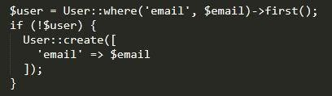

Laravel Tips
2. XorY Methods
Ex 2 – firstOrCreate():
Instead of:
Do this:

Slide 6
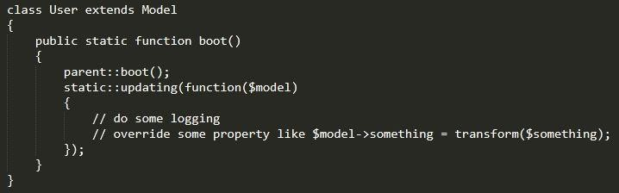
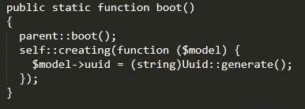
Laravel Tips
3. Model boot() method
There is a magical place called boot() in an Eloquent model where you can override default behavior:
Probably one of the most popular examples is setting some field value at the moment of creating the model object.

Slide 7


Laravel Tips
4. Relationship with conditions and ordering
Define Relationship:
Already add where or orderBy?
For example, if you want a specific relationship for some type of users, also ordered by email, you can do this:

Slide 8
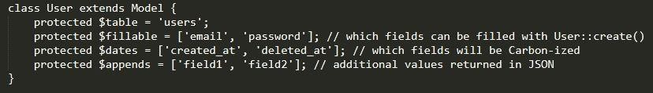
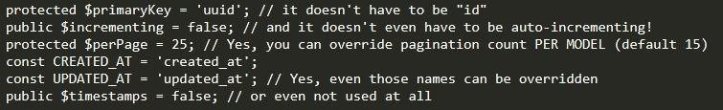
Laravel Tips
5. Model properties: timestamps, appends etc.
There are a few “parameters” of an Eloquent model, in the form of properties of that class. The most popular ones are probably these:
there’s more:

Slide 9


Laravel Tips
6. Find multiple entries
find() Method
Few people know about that it can accept multiple IDs as an array:

Slide 10


Laravel Tips
7. WhereX
There’s an elegant way to turn this:
Do this:
Also, there are some pre-defined methods in Eloquent, related to date/time:

Slide 11

Laravel Tips
8. Order by Relationship
Separate relationship for the latest post on the topic:
And then, in our controller, we can do this “magic”:

Slide 12
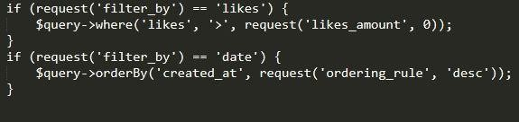
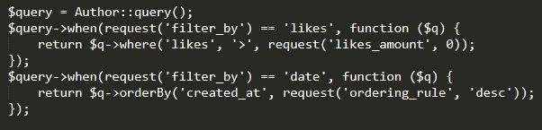
Laravel Tips
9 Eloquent::when() – no more if-else’s
write conditional queries with “if-else”, something like this:
there’s a better way – to use when():

Slide 13
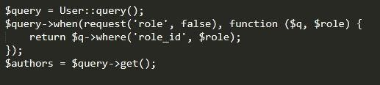
Laravel Tips
9 Eloquent::when() – no more if-else’s
It may not feel shorter or more elegant, but the most powerful is passing of the parameters:

Slide 14


Laravel Tips
10 BelongsTo Default Models
Post belonging to Author and then Blade code:
But what if the author is deleted, or isn’t set for some reason? You will get an error, something like “property of non-object”.
Of course, you can prevent it like this:
But you can do it on Eloquent relationship level:

Slide 15

Laravel Tips
11 Order by Mutator
Guess you have this:
Now, you want to order by that full_name? This won’t work:
Solution is simple. We need to order the results after we get them.
Function name is different – it’s not orderBy, it’s sortBy.

Slide 16
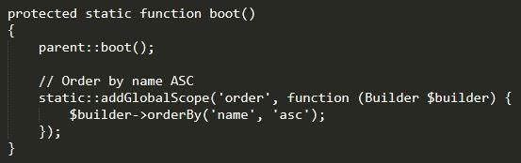
Laravel Tips
12 Default ordering in global scope
What if you want to have User::all() always be ordered by name field? You can assign a global scope. Let’s go back to the boot() method, which we mentioned already above.

Slide 17
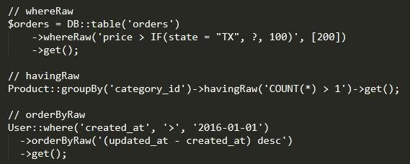
13 Raw query methods
Add raw queries to our Eloquent statements. functions for that.

Slide 18

Laravel Tips
14 Replicate: make a copy of a row
Short one. Without deep explanations, here’s the best way to make a copy of database entry:

Slide 19

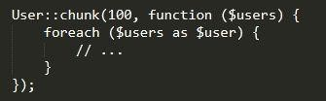
Laravel Tips
15 Chunk() method for big tables
Still powerful – to process bigger datasets, you can chunk them into pieces. Instead of:
Do this:

Slide 20


Laravel Tips
16 Create additional things when creating a model
This Artisan command:
There are three useful flags to generate related files to the model?
m will create a migration file
c will create a controller
r will indicate that controller should be resourceful

Slide 21

Laravel Tips
17 Override updated_at when saving
->save() method can accept parameters? As a result, we can tell it to
“ignore” updated_at default functionality to be filled with current timestamp.
See this:
Overriding default updated_at with our pre-defined one.

Slide 22
Laravel Tips
18 What is the result of an update()?
This code actually returns?
what would that $result contain? The answer is affected rows. So if you need to check how many rows were affected, you don’t need to call anything else – update() method will return this number for you.

Slide 23

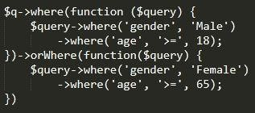
Laravel Tips
19 Transform brackets into an Eloquent query
and-or mix SQL query, like this:
How to translate it into Eloquent? This is the wrong way:
The order will be incorrect. The right way is a little more complicated, using closure functions as sub-queries:

Slide 24


Laravel Tips
20 orWhere with multiple parameters
pass an array of parameters to orWhere(). “Usual” way:
Do this:

Slide 25

Laravel Tips
21 onDelete('set null')
Used onDelete('cascade'); on foreign keys in Laravel migrations, know about 'set null'? This allows you to preserve models when their related model is deleted.

Slide 26
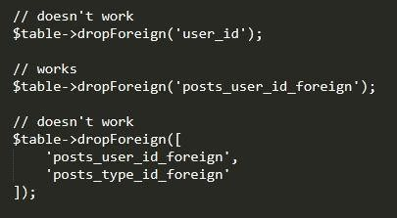
Laravel Tips
22 dropForeign([]);
when rolling back multiple foreign keys using array syntax didn't work.
the array syntax on dropForeign is for dropping a foreign key using a shorthand column name.

Slide 27
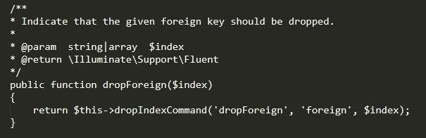
Laravel Tips
22 dropForeign([]);
Here is drop foreign:

Slide 28
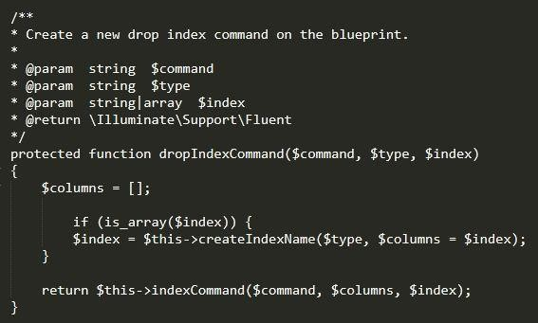
Laravel Tips
22 dropForeign([]);
abstracted call to dropIndexCommand which looks like this:

Slide 29
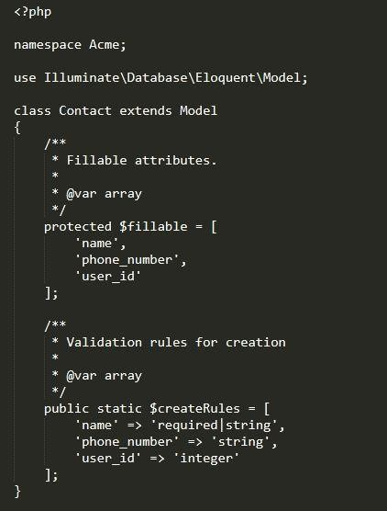
Laravel Tips
23 Model Validation
This approach was inspired by the Elixir framework, Phoenix.

Slide 30
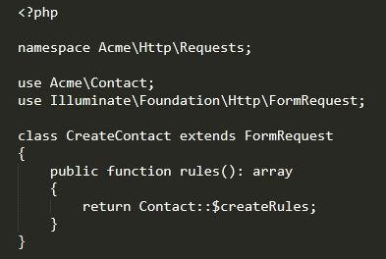
Laravel Tips
23 Model Validation

Slide 31
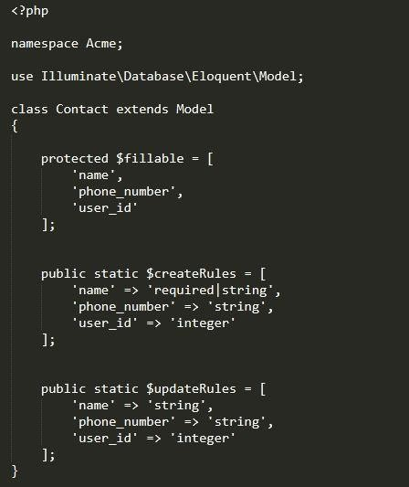
Laravel Tips
23 Model Validation
if your front-end only ends values that have changes for updating, you don't want all fields marked as required.

Slide 32
THANKS!

